Slide 1
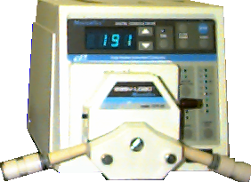
Acid Precipitation, Acid Mine Drainage, and Remediation of Acid Lakes
“Acid Rain or Acid Mine Drainage”
pH Probe
Peristaltic Pump
“Lake”

Slide 2
logistics
Prelabs done in teams
Fundamentals lab report done in teams
Show both team members data for measurements that you did individually.
Submit both the excel spreadsheet AND a markdown file with analysis/graph/report
Absorbance vs concentration
Textbook feedback
Cocreators of this educational space

Slide 3
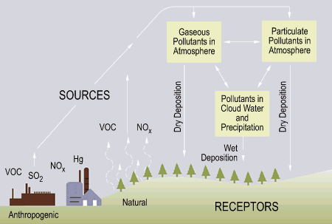
What is the Acid Source?
Data source: www.usepa.gov.
Notes:
Can also be fomed from lightening strikes or volcanic eruptions
Primary source of Sox and Nox – electric generation, factory smoke stacks, automobile emissions
Sulfer and nitrogen oxides
Mine drainage is formed when pyrite, an iron sulfide, is exposed and reacts with air and water to form sulfuric acid and dissolved iron.
Acid Mine Drainage (AMD) is currently the main pollutant of surface water in the mid-Atlantic region. (http://www.sosbluewaters.org/epa-what-is-acid-mine-drainage%5B1%5D.pdf)

Slide 4
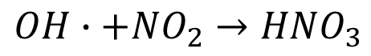
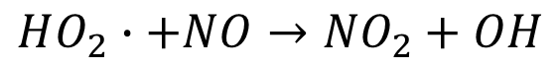
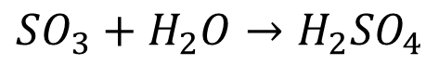
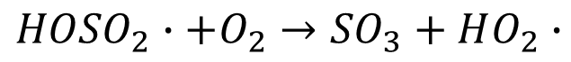
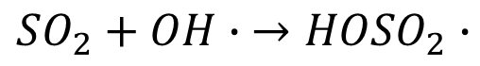
Chemistry of Acid Rain Formation
Combustion product precursors to acid rain
Reactions
$$SO_{2}+OH∙ →{HOSO}_{2}∙$$
$$HO_{2}∙+NO→{NO}_{2}+OH$$
$${HOSO}_{2}∙+O_{2}→{SO}_{3}+HO_{2}∙$$
$$SO_{3}+H_{2}O→H_{2}{SO}_{4}$$
$$OH∙+{NO}_{2}→{HNO}_{3}$$
Strong acids
Sulfuric acid
Nitric acid
Notes:
Sulfur dioxide – a toxic gas
hydroxysulfonyl (HOSO2) radical
Sulfur trioxide
Hydroperoxyl radical
Nitric oxide (nitrogen monooxide)
Nitrogen dioxide
Hydroxyl radical formed from reaction by excited atomic oxygen with water

Slide 5
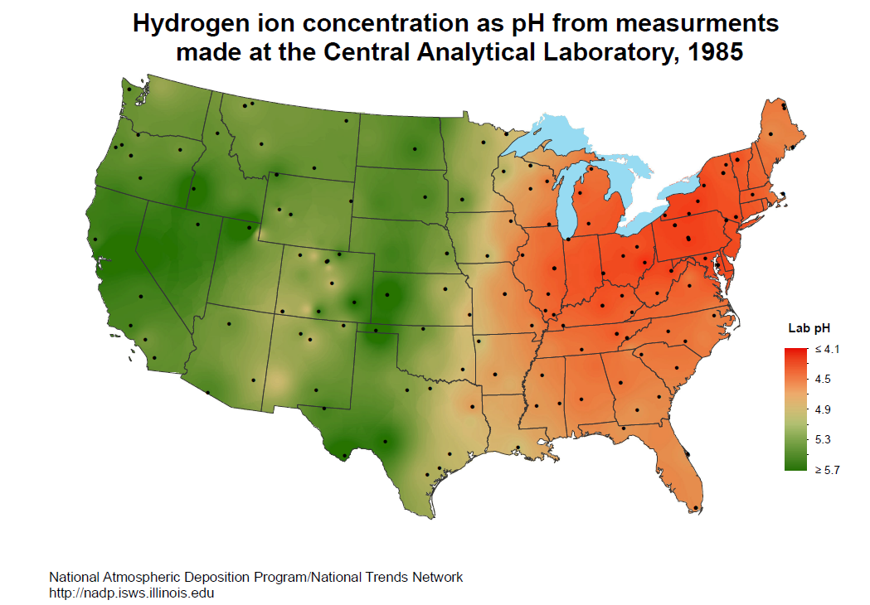
Where is Acid Rain Falling?
Notes:
Mystery! Why is the pH never above 5.7? Is this from pollution? I thought water would have a pH of 7!
Fall Creek and Cayuga lake always have a pH of 8.3. Why?

Slide 6
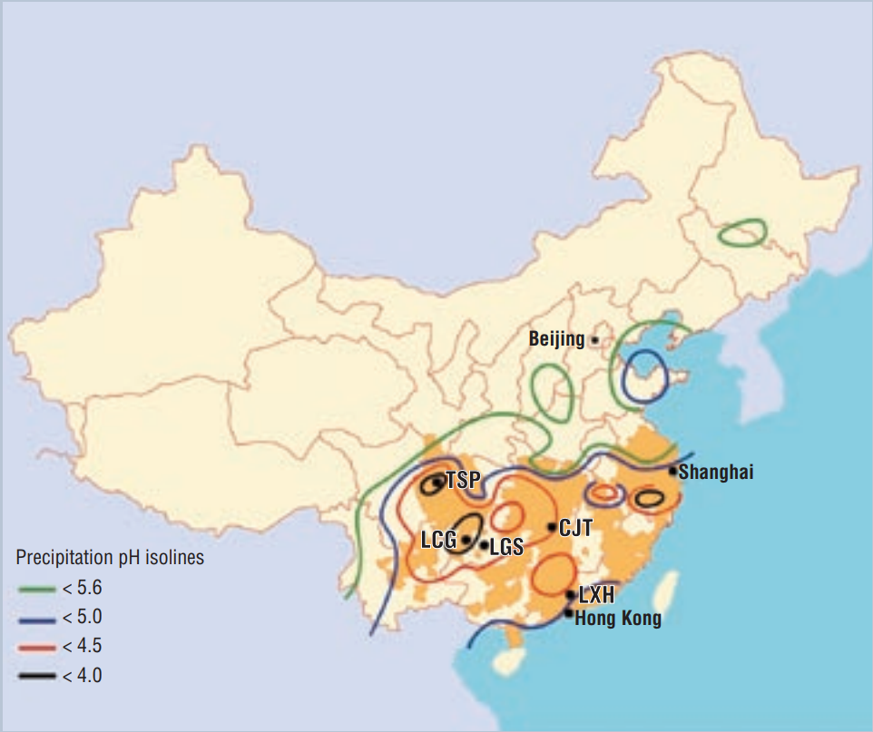
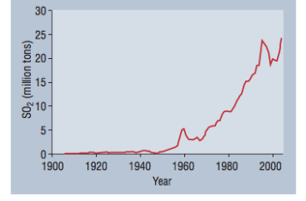
Acid Rain is a growing problem in Asia
Notes:
https://uosm2018.wordpress.com/2014/03/18/acid-rain-in-china-outlining-the-causes-distribution-and-impacts/
http://pubs.acs.org/doi/pdf/10.1021/es0626133

Slide 7
What Determines Lake Susceptibility to Acidification?
Acidification = f(acid inputs, ANC)
Acid inputs = f(power plants, cars, wind currents, mine tailings)
Acid Neutralizing Capacity = f(?)
Carbonates obtained from dissolution of minerals such as
CaCO₃ (calcite or aragonite)
MgCO₃ (magnesite)
CaMgCO₃ (dolomite)
...
Notes:
Cayuga lake has always had a pH of about 8.3 even during the acid rain years.

Slide 8
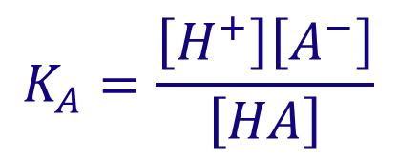
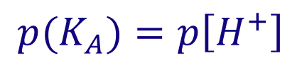
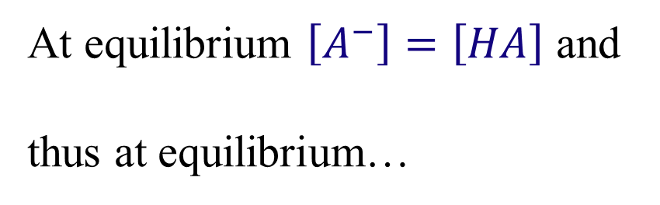
The p function
p(x) = -log₁₀(x)
$$K_{A}=\frac{\left[H^{+}\right]\left[A^{−}\right]}{\left[HA\right]}$$
Equilibrium constant for a monoprotic acid
$${p(K}_{A})=p\left[H^{+}\right]+p\left[A^{−}\right]−p\left[HA\right]$$
At equilibrium $\left[A^{−}\right]=\left[HA\right]$ and
thus at equilibrium…
$${p(K}_{A})=p\left[H^{+}\right]$$
Notes:
At the pH = pKa the reaction is happening!

Slide 9
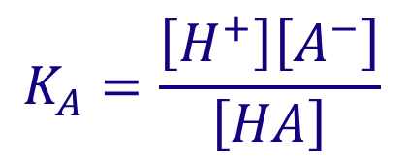
Fate of Strong Acids in the Environment
$$K_{A}=\frac{\left[H^{+}\right]\left[A^{−}\right]}{\left[HA\right]}$$
Strong acids completely dissociate in water
pK= -1
pK₁= -3, pK₂=1.9
If 0.1 mol of nitric acid is added to 1 liter of pure water, what is the concentration of H⁺? _________
What is the pH? [pH = -log[H⁺]] ________
What else can happen to the hydrogen ions if it isn’t pure water? ________________
0.1 M
1
reactions
Notes:
What does a pK of -1 mean?
Species are in equilibrium at pH of -1
At a pH of -1, H+ = 10 moles of hydrogen ions/Liter
How many hydrogens are in 1 liter? 1000 gram/(9 gram/mole of H) = 111 moles of hydrogen per liter of water
initial pH = 7 so H⁺=10⁻⁷ In this case this is negligible
added H⁺ = 10⁻¹
final H⁺ = 10⁻¹
final pH = 1
NO REACTIONS so H+ is conserved.

Slide 10
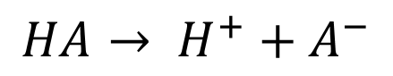

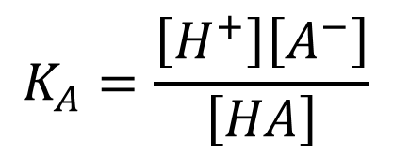


Fate of Strong Acids: Reactions
Weak acids/bases can react with the added H⁺ and reduce the final concentration of H⁺
Examples of weak acids and bases in the environment:
carbonates
carbonate, bicarbonate, carbonic acid
organic acids (A⁻)
acetic acid (pK = 4.7)
$${CO}_{3}^{2−}$$
$${HCO}_{3}^{−}$$
$$H_{2}CO_{3}$$
$$HA→ H^{+}+A^{−}$$
$$K_{A}=\frac{\left[H^{+}\right]\left[A^{−}\right]}{\left[HA\right]}$$
When [A⁻] = [HA] then K_{A} = [H⁺]
Notes:
Thus organic acid reactions are happening around pH 4.7

Slide 11
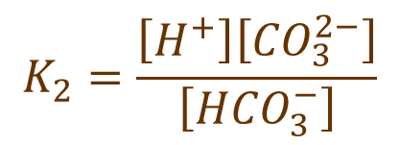
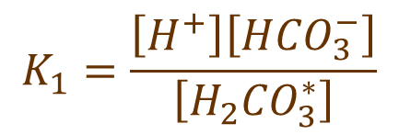
Carbonate System
species
>>
definition
$$\left[H_{2}{CO}_{3}^{∗}\right]= \left[{CO}_{2(aq)}\right]+ \left[H_{2}CO_{3}\right]$$
$$K_{1}=\frac{\left[H^{+}\right]\left[H{CO}_{3}^{−}\right]}{\left[H_{2}{CO}_{3}^{∗}\right]}$$
Equilibrium
Constant
6.3
$$K_{2}=\frac{\left[H^{+}\right]\left[{CO}_{3}^{2−}\right]}{\left[H{CO}_{3}^{−}\right]}$$
10.3
Notes:
We can’t easily distinguish dissolved CO2 gas from carbonic acid. So we treat them as one entity.
If we start with calcium carbonate
When it dissolves we get carbonate.
Add acid (hydrogen ions) we get bicarbonate or hydrogen carbonate
Add more acid and we get carbonic acid or CO2 gas.

Slide 12
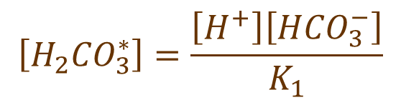
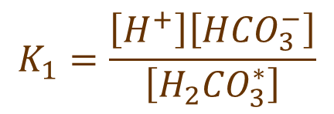
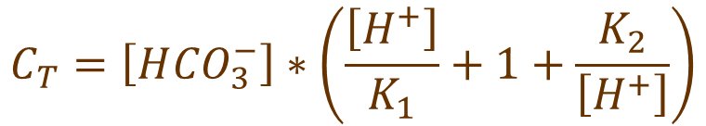
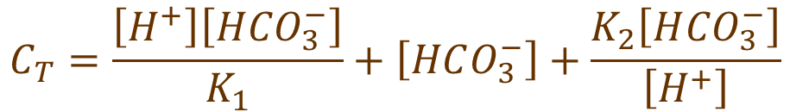
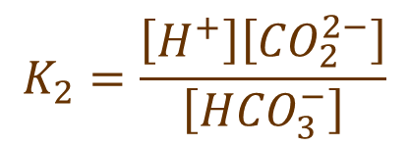
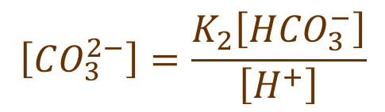
Alpha Notation and Equilibrium Constants will help us calculate concentrations
Carbon dioxide
carbonic acid
bicarbonate
carbonate
$$C_{T}= \left[H_{2}CO_{3}^{∗}\right]+\left[HCO_{3}^{−}\right]+\left[CO_{3}^{2−}\right]$$
Total carbonate species
$$K_{1}=\frac{\left[H^{+}\right]\left[H{CO}_{3}^{−}\right]}{\left[H_{2}{CO}_{3}^{∗}\right]}$$
$$\left[H_{2}{CO}_{3}^{∗}\right]=\frac{\left[H^{+}\right]\left[H{CO}_{3}^{−}\right]}{K_{1}}$$
$$K_{2}=\frac{\left[H^{+}\right]\left[{CO}_{2}^{2−}\right]}{\left[H{CO}_{3}^{−}\right]}$$
$$\left[CO_{3}^{2−}\right]=\frac{K_{2}\left[H{CO}_{3}^{−}\right]}{\left[H^{+}\right]}$$
$$C_{T}=\frac{\left[H^{+}\right]\left[H{CO}_{3}^{−}\right]}{K_{1}}+\left[HCO_{3}^{−}\right]+\frac{K_{2}\left[H{CO}_{3}^{−}\right]}{\left[H^{+}\right]}$$
$$C_{T}=\left[H{CO}_{3}^{−}\right]∗\left(\frac{\left[H^{+}\right]}{K_{1}}+1+\frac{K_{2}}{\left[H^{+}\right]}\right)$$
Notes:
Eliminate carbonic acid and carbonate from this equation to get bicarbonate concentration as a function of total carbonates and pH

Slide 13
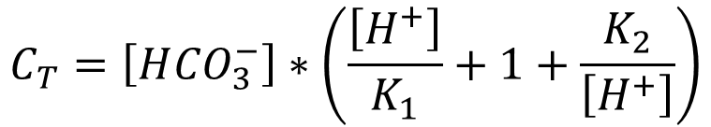
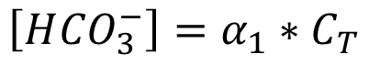
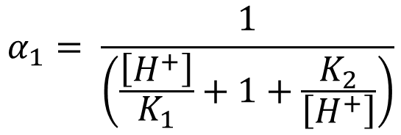
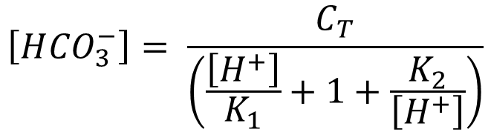
Alphas: the fraction of the total carbonates in each species
$$C_{T}=\left[H{CO}_{3}^{−}\right]∗\left(\frac{\left[H^{+}\right]}{K_{1}}+1+\frac{K_{2}}{\left[H^{+}\right]}\right)$$
$$\left[H{CO}_{3}^{−}\right]= \frac{C_{T}}{\left(\frac{\left[H^{+}\right]}{K_{1}}+1+\frac{K_{2}}{\left[H^{+}\right]}\right)}$$
$$α_{1}= \frac{1}{\left(\frac{\left[H^{+}\right]}{K_{1}}+1+\frac{K_{2}}{\left[H^{+}\right]}\right)}$$
define →
$$\left[H{CO}_{3}^{−}\right]=α_{1}∗C_{T}$$

Slide 14
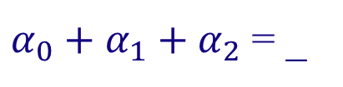
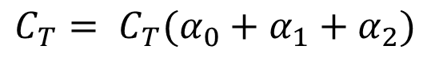
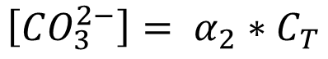
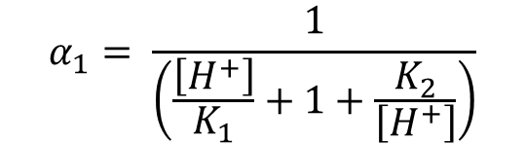
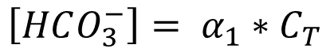
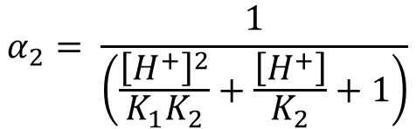
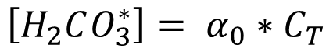
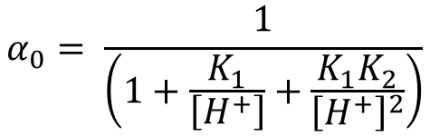
Alpha Notation
All carbonate species concentrations are related to the hydrogen ion concentration
$$C_{T}= \left[H_{2}CO_{3}^{∗}\right]+\left[HCO_{3}^{−}\right]+\left[CO_{3}^{2−}\right]$$
$$α_{0}= \frac{1}{\left(1+\frac{K_{1}}{\left[H^{+}\right]}+\frac{K_{1}K_{2}}{{\left[H^{+}\right]}^{2}}\right)}$$
$$α_{1}= \frac{1}{\left(\frac{\left[H^{+}\right]}{K_{1}}+1+\frac{K_{2}}{\left[H^{+}\right]}\right)}$$
$$α_{2}= \frac{1}{\left(\frac{{\left[H^{+}\right]}^{2}}{K_{1}K_{2}}+\frac{\left[H^{+}\right]}{K_{2}}+1\right)}$$
$$\left[H_{2}CO_{3}^{∗}\right]= α_{0}∗C_{T}$$
$$\left[HCO_{3}^{−}\right]= α_{1}∗C_{T}$$
$$\left[CO_{3}^{2−}\right]= α_{2}∗C_{T}$$
$$C_{T}= C_{T}(α_{0}+α_{1}+α_{2})$$
1
$α_{0}+α_{1}+α_{2}$ = _
Notes:
The dimensionless fractions must sum to one!

Slide 15


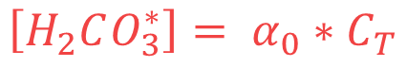
pH Diagram
$$\left[H_{2}CO_{3}^{∗}\right]= α_{0}∗C_{T}$$
$$\left[HCO_{3}^{−}\right]= α_{1}∗C_{T}$$
$$\left[CO_{3}^{2−}\right]= α_{2}∗C_{T}$$
Add acid to a carbonate solution at pH 9. What happens?
Notes:
Dominant species initially is bicarbonate
As we add acid bicarbonate converts into carbonic acid and the carbonic acid concentration increases.
This reaction means that hydrogen ions aren’t conserved! They can react to form new species.

Slide 16



Acid Neutralizing Capacity (ANC)
The ability to neutralize (react with) acid
ANC has units of _______________ or eq/L
Possible reactants in environment:
moles of protons/L
$${HCO}_{3}^{−}$$
$${CO}_{3}^{2−}$$
$$OH^{−}$$
2

Slide 17
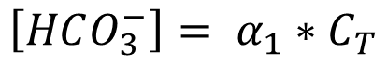
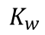
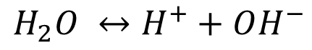
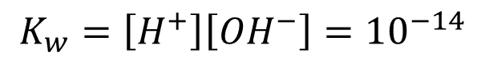
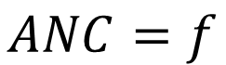
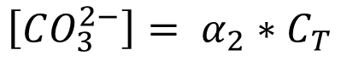

Hydrogen Ion Concentration: The Master Variable
$$ANC= \left[{HCO}_{3}^{−}\right]+2\left[{CO}_{3}^{−2}\right]+ \left[{OH}^{−}\right] − \left[H^{+}\right]$$
$$\left[HCO_{3}^{−}\right]= α_{1}∗C_{T}$$
$$\left[CO_{3}^{2−}\right]= α_{2}∗C_{T}$$
$$K_{w}$$
$$K_{w}=\left[H^{+}\right]\left[{OH}^{−}\right]={10}^{−14}$$
$$H_{2}O ↔H^{+}+OH^{−}$$
$$ANC= C_{T }\left(α_{1}+2α_{2}\right)+\frac{K_{w}}{\left[H^{+}\right]}− \left[H^{+}\right]$$
$$ANC=f$$
(pH, C_{T})

Slide 18
ANC properties
ANC = capacity to react with H⁺ minus the concentration of H⁺
ANC can be positive or __________
ANC is conservative!
Example: 10 liters of a solution with an ANC of 0.1 meq/L is mixed with 5 liters of a solution with an ANC of -1 meq/L. What is the final ANC?
negative
$$\frac{{ANC}_{1}∗{V_{1}+ ANC}_{2}∗ V_{2}}{V_{1}+ V_{2}}=\frac{\left(0.1\frac{meq}{L}\right)∗\left(10L\right)+\left(−1\frac{meq}{L}\right)∗(5L)}{(10L+5L)}=−0.267 \frac{meq}{L}$$
Notes:
ANC and dissolved inorganic carbon (DIC) are conservative quantities with respect to mixing and changes in temperature and pressure

Slide 19
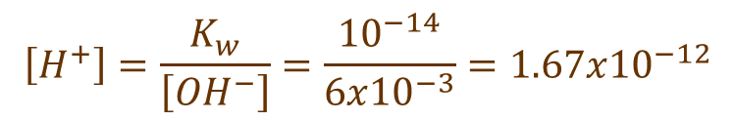

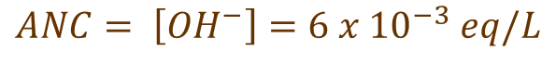
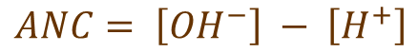
ANC Example
no carbonates
Suppose we add 3 mM Ca(OH)₂ to distilled water. What is the ANC?
$$ANC= \left[{HCO}_{3}^{−}\right]+2\left[{CO}_{3}^{−2}\right]+ \left[{OH}^{−}\right] − \left[H^{+}\right]$$
$$ANC= \left[{OH}^{−}\right] − \left[H^{+}\right]$$
[H⁺] is small
$$ANC= \left[{OH}^{−}\right]=6 x {10}^{−3} eq/L$$
p(OH)=
2.22
What is the resulting pH if the system is closed to the atmosphere?
$$K_{w}=\left[H^{+}\right]\left[{OH}^{−}\right]={10}^{−14}$$
$$\left[H^{+}\right]=\frac{K_{w}}{\left[{OH}^{−}\right]}=\frac{{10}^{−14}}{6x{10}^{−3}}=1.67x{10}^{−12}$$
pH=
11.78
Notes:
neglect the initial [OH-] concentration

Slide 20

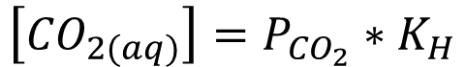
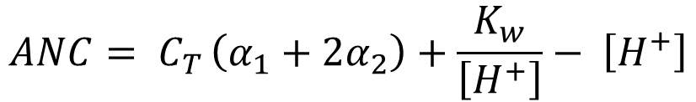
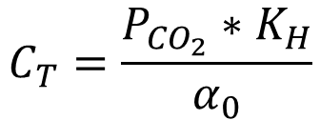
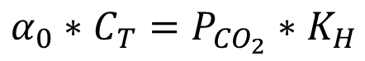

More Complications: Open to the Atmosphere
Henry’s constant
Natural waters exchange carbon dioxide with the atmosphere
$$\left[{CO}_{2(aq)}\right]=P_{{CO}_{2}}∗K_{H}$$
$$\left[{CO}_{2(aq)}\right]=α_{0}∗C_{T}$$
The total concentration of carbonate species is affected by this exchange
$$α_{0}∗C_{T}=P_{{CO}_{2}}∗K_{H}$$
Is ANC affected? _____
NO!
$$C_{T}=\frac{P_{{CO}_{2}}∗K_{H}}{α_{0}}$$
$$ANC= C_{T }\left(α_{1}+2α_{2}\right)+\frac{K_{w}}{\left[H^{+}\right]}− \left[H^{+}\right]$$
$$ANC=\frac{P_{{CO}_{2}}∗K_{H}}{α_{0}}\left(α_{1}+2α_{2}\right)+\frac{K_{w}}{\left[H^{+}\right]}− \left[H^{+}\right]$$

Slide 21



ANC Example (continued)
Suppose we aerate the 3 mM Ca(OH)₂ solution. What happens to the pH?
All the alphas are functions of pH and it is not possible to solve explicitly for [H⁺].
Solution techniques
numerical methods (pH=9, C_{T}=0.0057M)
$$ANC=\frac{P_{{CO}_{2}}∗K_{H}}{α_{0}}\left(α_{1}+2α_{2}\right)+\frac{K_{w}}{\left[H^{+}\right]}− \left[H^{+}\right]$$
$$pH=−log\left[H^{+}\right]$$
$\left[H^{+}\right]={10}^{−pH}$
Beware of precision!

Slide 22
Open vs. Closed to the Atmosphere
What is conserved in an open (volatile) system? _____________
What is conserved in a closed (nonvolatile) system? _____________
For conservative species we can use the Completely Mixed Flow Reactor equation to model a well mixed lake
ANC
ANC
C_{T}

Slide 23



Completely Mixed Flow Reactor
C
Q, C_{in}
Q, __
V, C
Mass in – Mass out = Increase of Mass in reactor
$${QC}_{in}−QC=V\frac{dC}{dt}$$
Mass balance
Hydraulic Residence Time
$$dt∗\frac{Q}{V}=\frac{dC}{\left(C_{in}−C\right)}$$
$$\frac{V}{Q}=θ$$

Slide 24

Completely Mixed Flow Reactor
$$\int_{0}^{t}{\frac{1}{θ}}dt=\int_{C_{0}}^{C}{\frac{dC}{\left(C_{in}−C\right)}}$$
Set up integration
$$C=C_{in}∗\left(1−e^{−t/θ}\right)+C_{0}∗e^{−t/θ}$$
C_{in}
What is C when t is large? _______
Equation applies to any conservative species.
C₀ = time zero concentration in reactor
C_{in} = influent concentration
C = concentration in the reactor as a function of time
and effluent!

Slide 25

Three Equations for C_{T} in CMFR
CMFR for conservative species. (True if nonvolatile!)
If in equilibrium with atmospheric CO₂...
Can we measure C_{T}?
Assuming no carbonates in influent
$$C_{T}=\frac{P_{{CO}_{2}}∗K_{H}}{α_{0}}$$
Notes:
Remember, CT is total carbonate species

Slide 26


What is the measured concentration of carbonates?
Measured C_{T}?
What is ANC?
$$ANC= C_{T }\left(α_{1}+2α_{2}\right)+\frac{K_{w}}{\left[H^{+}\right]}− \left[H^{+}\right]$$
$$C_{T}= {\frac{ANC−\frac{K_{w}}{\left[H^{+}\right]}+ \left[H^{+}\right]}{\left(α_{1}+2α_{2}\right)}}_{ }$$
$$ANC={ANC}_{in}∗\left(1−e^{−t/θ}\right)+{ANC}_{0}∗e^{−t/θ}$$

Slide 27
Measuring ANC: Gran Titration
The sample is titrated with a strong acid to "cancel" the sample ANC
At the equivalence point the sample ANC is zero
Further titration will result in an increase in the number of moles of H⁺ equal to the number of moles of H⁺ added.
Use the fact that ANC is conservative...

Slide 28


Conservation of ANC
T = titrant
S = sample
$$V_{T}∗{ANC}_{T}+V_{s}∗{ANC}_{s}={(V_{s}+V_{T})ANC}_{T+S}$$
$$V_{e}= V_{T} such that {ANC}_{T+S}=0$$
equivalent
V_{e}= ___________ volume
= volume of titrant added so that ANC = 0
$$V_{e}∗{ANC}_{T}+V_{s}∗{ANC}_{s}=0$$
$${ANC}_{s}=\frac{{−V}_{e}∗{ANC}_{T}}{V_{s}}$$
Need to find ANC_{T} and V_{e}
Notes:
What we are trying to get at in ANCs

Slide 29



ANC of Titrant
$$ANC= C_{T }\left(α_{1}+2α_{2}\right)+\frac{K_{w}}{\left[H^{+}\right]}− \left[H^{+}\right]$$
$${ANC}_{T}={−N}_{T}$$
N_{T} = [H⁺]
Why? ___________
$$V_{T}∗{ANC}_{T}+V_{s}∗{ANC}_{s}={(V_{s}+V_{T})ANC}_{T+S}$$
$${ANC}_{s}=\frac{{−V}_{e}∗{ANC}_{T}}{V_{s}}$$
$${−N}_{T}∗(V_{T}−V_{e}) ={(V_{s}+V_{T})ANC}_{T+S}$$
what is ANC_{T+S}?
When can we measure ANC with a pH probe? _______________________________________
When pH is so low that no reactions are occurring.

Slide 30



ANC of Titrated Sample
$$ANC= C_{T }\left(α_{1}+2α_{2}\right)+\frac{K_{w}}{\left[H^{+}\right]}− \left[H^{+}\right]$$
$${−N}_{T}∗(V_{T}−V_{e}) ={(V_{s}+V_{T})ANC}_{T+S}$$
$${ANC}_{T+S}=−\left[H^{+}\right]$$
For pH << pK₁
When is this true? ____________
$${−(V}_{T}−V_{e})∗N_{T}=−(V_{s}+V_{T})∗\left[H^{+}\right]$$
$$V_{e}=V_{T}−\frac{(V_{s}+V_{T})∗\left[H^{+}\right]}{N_{T}}$$
Finally! An equation for equivalent volume!
Notes:
This equation for equivalent volume is only true for pH<<pK1

Slide 31



Gran Function
A better measure of the equivalent volume can be obtained by rearranging the equation so that linear regression on multiple titrant volume - pH data pairs can be used.
Define F₁ as:
$$V_{e}=V_{T}−\frac{(V_{s}+V_{T})∗\left[H^{+}\right]}{N_{T}}$$
$$\frac{(V_{s}+V_{T})∗\left[H^{+}\right]}{V_{s}}=\frac{N_{T}V_{T}}{V_{S}}−\frac{N_{T}V_{e}}{V_{S}}$$
$$F_{1}=\frac{(V_{s}+V_{T})∗\left[H^{+}\right]}{V_{s}}$$

Slide 32





Gran Plot
$$F_{1}=\frac{N_{T}V_{T}}{V_{S}}−\frac{N_{T}V_{e}}{V_{S}}$$
0.0009
0.0008
0.0007
0.0006
0.0005
First Gran Function
$$y=mx+b_{y}$$
0.0004
0.0003
0.0002
$$m=\frac{N_{T}}{V_{S}}$$
$$b_{y}=−\frac{N_{T}V_{e}}{V_{S}}$$
0.0001
0
0
1
2
3
4
5
6
Volume of Titrant (mL)
$$b_{x}=\frac{{−b}_{y}}{m}=\frac{N_{t}V_{e}V_{s}}{V_{s}N_{t}}=V_{e}$$
V_{e}
Minimum value of F₁ before it is worth attempting analysis?
pH<4.3
3 points with F₁>0.0001
Algorithm for choosing points to include?
Notes:
How do you know if you should include the lowest point given that the lowest point might not be on the “straight” line?
Calculate means sum of squared errors with and without the lowest point.

Slide 33

Gran Plot using pH probe and ProCoDA
$$F_{1}=\frac{(V_{s}+V_{T})∗\left[H^{+}\right]}{V_{s}}$$
slope =
abscissa intercept of V_{e}
F₁ plotted as a function of V_{t}. The abscissa has units of mL of titrant and the ordinate is a Gran function with units of [H⁺].

Slide 34

Calculating ANC
The ANC is obtained from the equivalent volume.
The ANC of the acid rain can be estimated from its pH. At low pH (< pK₁) most of the carbonates will be carbonic acid and thus for pH below about 4.3 the ANC equation simplifies to
$$ANC= \frac{V_{e}N_{t}}{V_{s}}$$
$$ANC= \left[{HCO}_{3}^{−}\right]+2\left[{CO}_{3}^{−2}\right]+ \left[{OH}^{−}\right] − \left[H^{+}\right]$$

Slide 35
Titration Technique
Titrate with digital pipette ________________
Measure pH before first addition of titrant
Measure pH after each addition of titrant
After ANC is consumed Gran function will be linear
What should the incremental titrant volume be?
Techniques to speed up titration
Accuracy is important

Slide 36
Titrant Incremental Volume
Minimum? _______________________
Maximum?
Constraints?
Number of data points _____________
Before reaching pH___
How do we determine titrant volume?
H⁺ is conservative!
None except your patience
3 or more
3
Notes:
End before pH 3 because we are extrapolating in your measurements of pH

Slide 38
Freshwater pH: water quality issues/challenges
Source of Acid Rain
History of Acid Rain Research
Fate of strong acids in the environment
Reactions
Carbonate System
Dissociation constants
Alpha notation
p-notation (pK₁, etc)
Volatile (open) vs non-volatile (closed)
Acid Neutralizing Capacity (ANC)
Defined
Measured – Gran Plot
Titration

Slide 39

The Global Problem of Acid Rain
Data source: Copyright © by Holt, Rinehart and Winston. All rights reserved.

Slide 40






History of Acid Rain Research
British writer noted the “corrosive effect of polluted, acidic city air” on the deterioration of marble sculptures
New York Times made the issue popular with a series of reports on damage to forest ecosystems wrought by acid rain
Eville Gorham – hypothesized SO₂ emissions could lead to acid rain
1600s
1852
1950s
1960s
1970s
1980
Robert Angus Smith – associated acidic rain with industrial pollution in Manchester, England
Harold Harvey – convinced the world of the causes and effects of acid rain
US Congress passes the Acid Deposition Act
Notes:
John Evelyn, an English writer, commented on the poor condition of the so called Arundel Marbles. These were a collection of ancient Greek marble sculptures that had been weathered. Likely from combustion for cooking or heating.
In 1852 the first connection between acidic rain and industrial pollution was made by Robert Angus Smith in Manchester England. He coined the term Acid Rain and in considered to be the father of the field of acid rain research.
Eville Gorham, while at Dalhousie University hypothesized that SO2 emitted from industry could be transported over great distances, react with sun light and moisture in the atmosphere and fall back to earth as acid. But his work focused on unknown aquatic plants and remained confined in the academic world. Destined to wallow with litte impact.
Harold Harvey was a Canadian ecologist from the University of Toronta who was the first person to really study acid rain as a scientific endeavor. He was a fish ecologist who was interested in the propagation of fish populations in Canadian lakes. He had a great test lake about 6 hours north of Toronto – the input was a waterfall and the outlet was dammed up with logs and debris. He stocked Pacific salmon thinking this pristine environment would be a suitable habitat for the western fish. They all died. He also noticed that native fish were smaller than normal. He made the connection to water pH, then to acid deposition and became a vocal leader in the cause to stop industrial pollution.
New York Times published investigative report on the many and varied negative effects of acid rain on an experimental forest in Neew Hampshire
US Congress passes the Acid Deposition Act which sanctioned scientific studies and research into the causes and effects of acid rain. This research led to a series of amendments to the clean air act and a number of programs enacted to reduce emissions of SOxs and Noxs.

Slide 41

Lake and/or Watershed Remediation
Add a soluble mineral such as lime (CaCO₃) or sodium bicarbonate (NaHCO₃)
Application options
________________
________________
________________
spread on watershed
meter into stream
apply directly to lake
Notes:
Dump (CaCO₃) or sodium bicarbonate (NaHCO₃) into lake
Why not NaOH?
make sure initial pH is okay
ANC will washout of lake

Slide 42
At what pH is ANC 0?
$$ANC= \left[{HCO}_{3}^{−}\right]+2\left[{CO}_{3}^{−2}\right]+ \left[{OH}^{−}\right] − \left[H^{+}\right]$$

Slide 43

1985

Slide 44

1986

Slide 45

1987

Slide 46

1988

Slide 47

1989

Slide 48

1990

Slide 49

1991

Slide 50

1992

Slide 51

1993

Slide 52

1994

Slide 53

1995

Slide 54

1996

Slide 55

1997

Slide 56

1998

Slide 57

1999

Slide 58

2001

Slide 59

2002

Slide 60

2003

Slide 61

2004

Slide 62

2005

Slide 63

2006

Slide 64

2007

Slide 65
2008

Slide 66

2009

Slide 67

2010

Slide 68

2011

